Slide 1




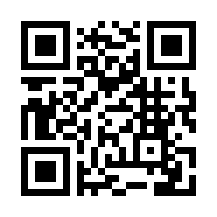
Premium Japanese Matcha
～From heritage farms to global market～
Company: Excellcia
WEB: www.excellcia-brand.com
Email: info@excellcia-brand.com

Slide 2

Characteristics
Your Direct Gateway
to Japan’s Finest Tea Estate
Versatile Supply: we supply everything from Ceremonial Grade to bulk-packaged (5kg) industrial solutions.
Global Compliance: With access to FDA, Halal, USDA Organic, and JAS certified products.
Market Expertise: Seamless logistics tailored specifically for Middle East, Southeast Asia and US.
Unrivaled Tea Network
We build direct partnerships with farmers or tea processed manufactures throughout Japan to ensure quality consistency.

Slide 3
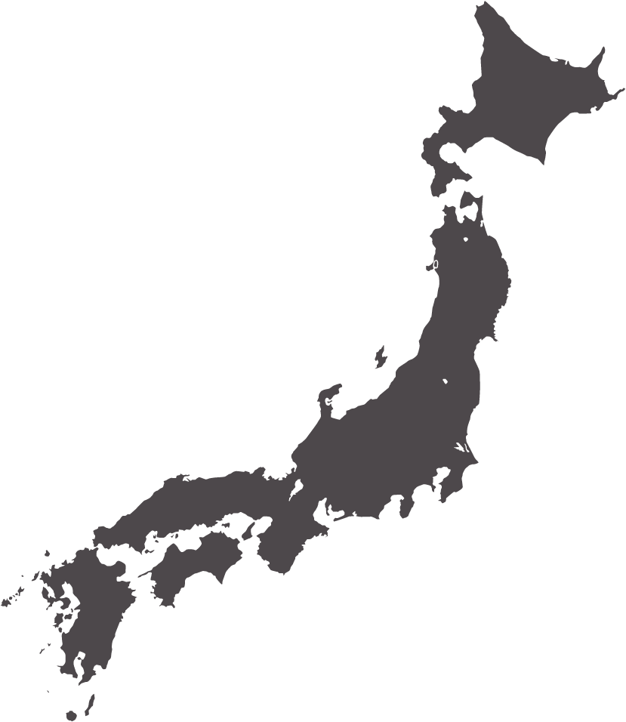
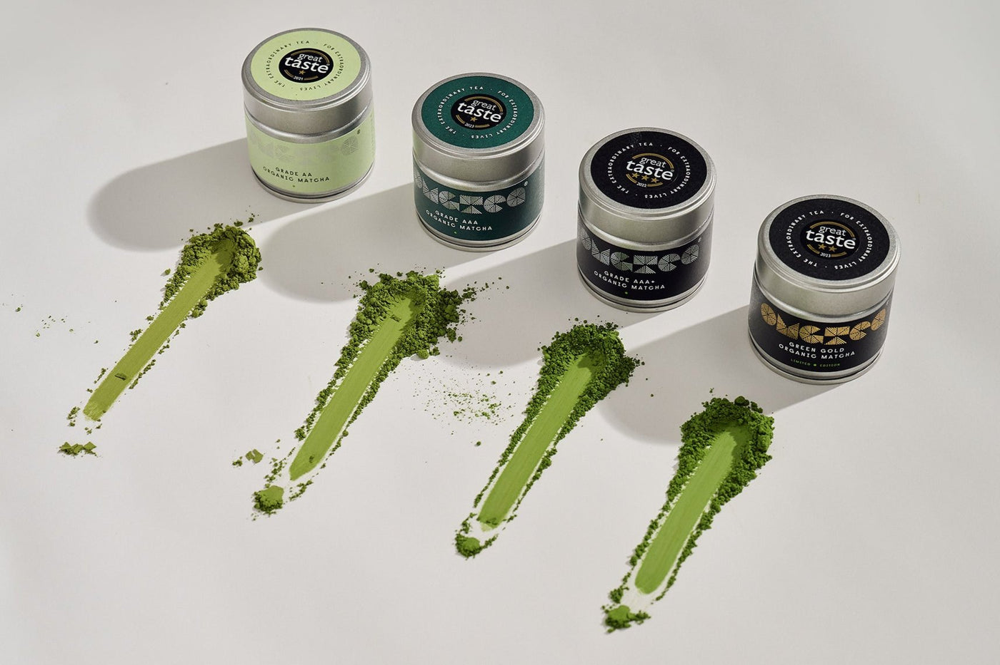
Our Origin
We create strong partnership with the farmers and processed manufactures all over Japan, such as Kyoto, Shizuoka and Kagoshima.
We provide optimal Matcha products according to customers requirements.
Flavor Profile Matrix
Grade | Umami | Ideal Application
Organic Ceremonial | ★★★★★ | Whisk Tea / Luxury Gifts
Premium | ★★★★☆ | Daily wellness / Premium Retail
Commercial | ★★☆☆☆ | Ice Cream / Baking / Lattes
Protein | ★★☆☆☆ | Smoothies / Fitness Recovery

Slide 4
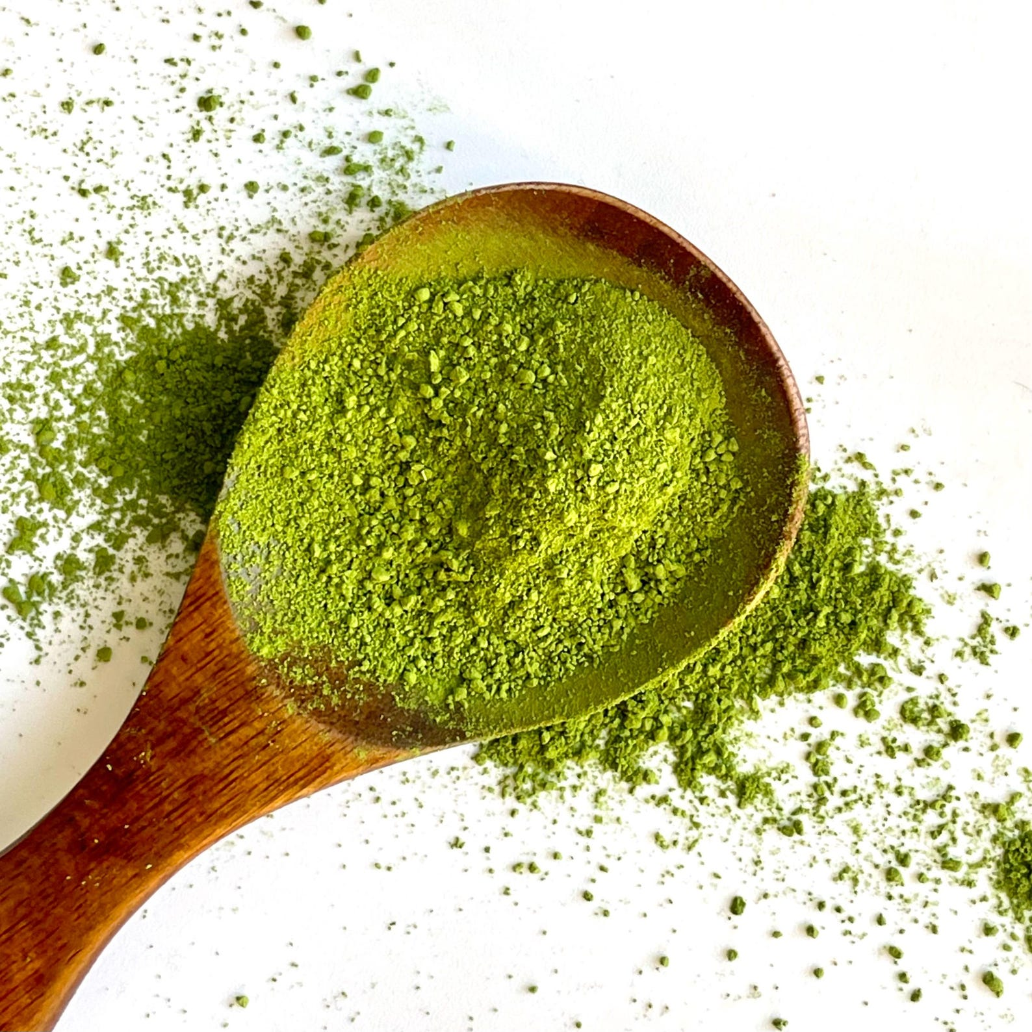
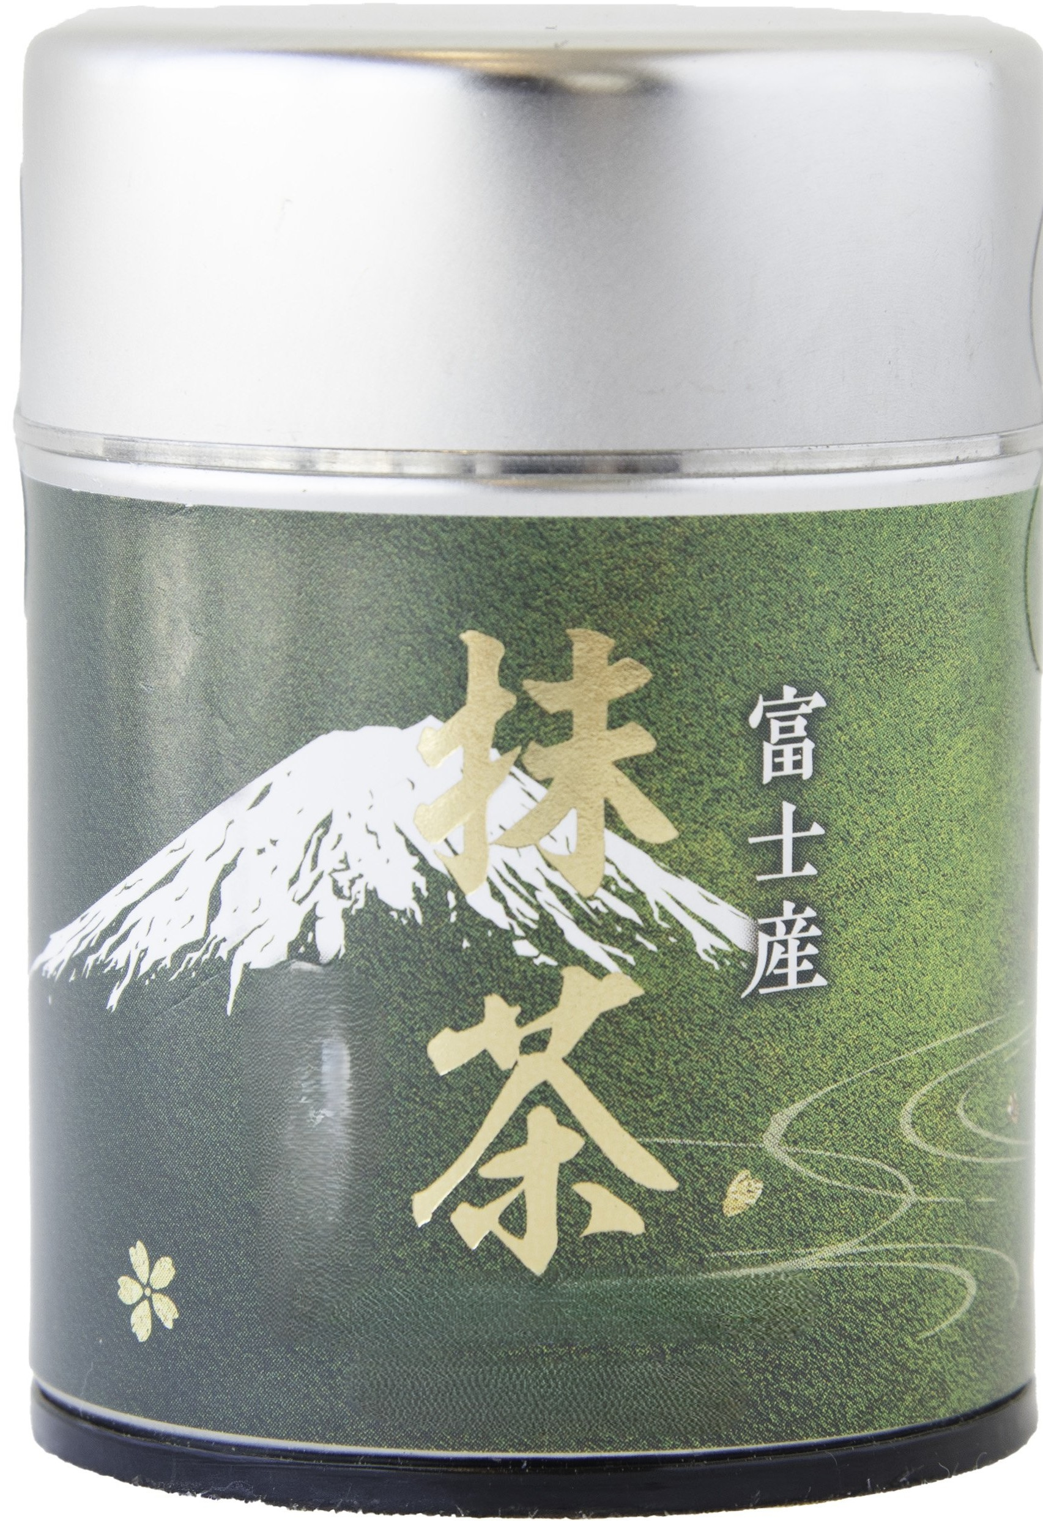
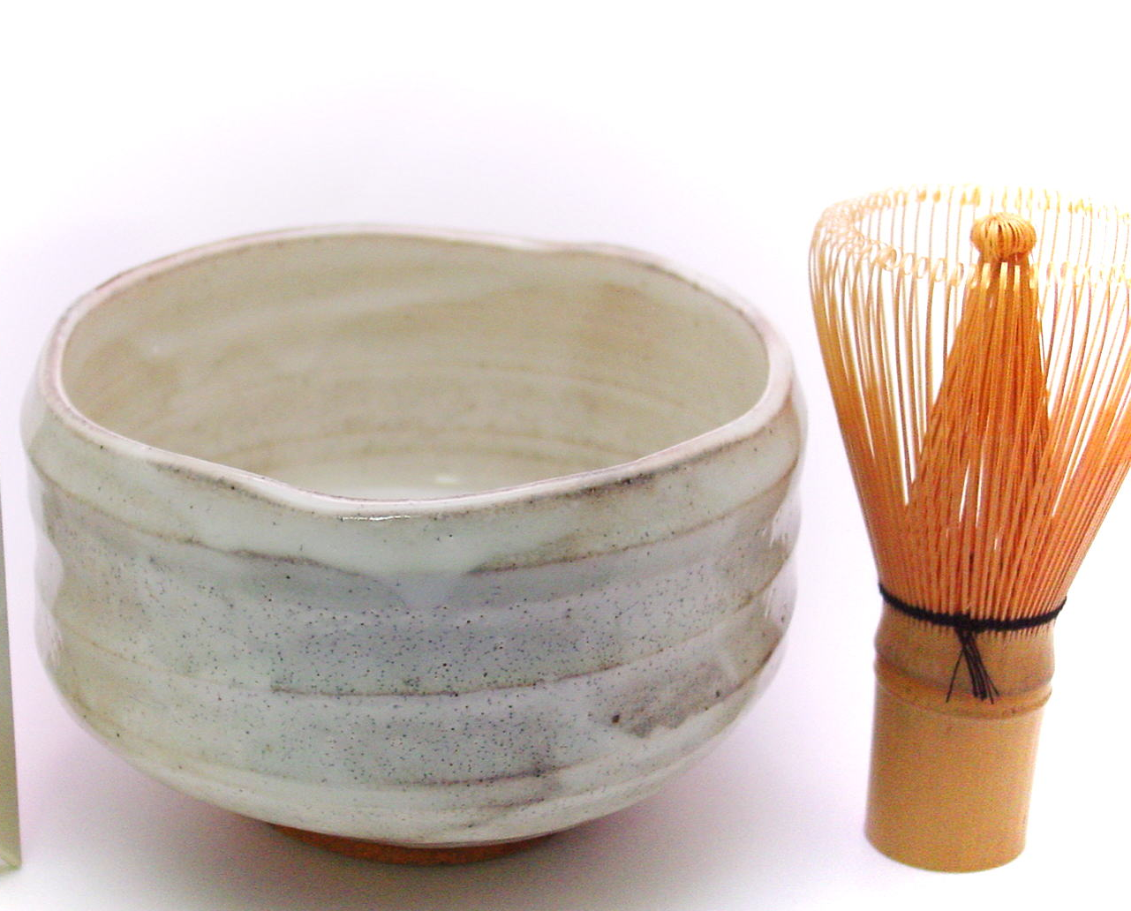
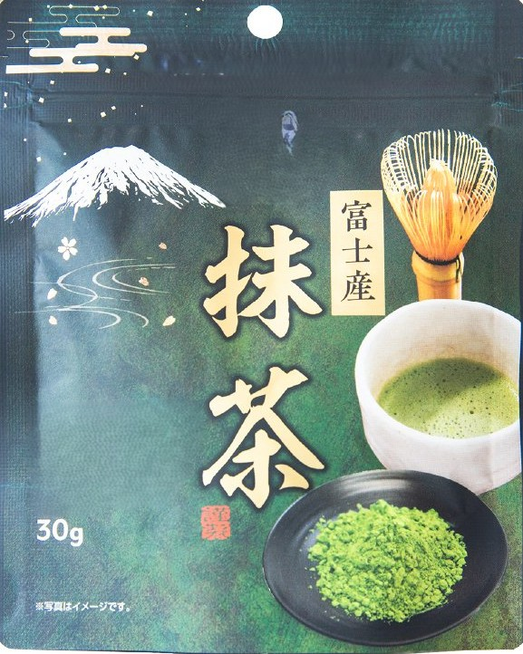
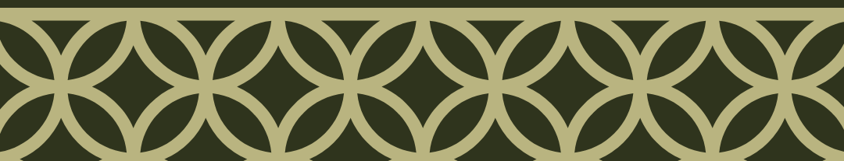
Product Lineup
Organic Ceremonial
Perfect for health-conscious boutique retailers and specialty health stores.
Origin | Shizuoka, Kyoto, Kagoshima, Fukuoka
Weight | 20g, 30g for retail packs
Certification | FDA, JAS, USDA Organic, Gluten free
Shelf Life | 12 Months
Ceremonial
Vibrant green color and rich umami profile for high-end tea ceremonies and luxury hotels
Origin | Shizuoka, Kyoto, Kagoshima, Fukuoka
Weight | 20g, 30g for retail packs
Certification | FDA, JAS, Gluten free
Shelf Life | 12 Months

Slide 5
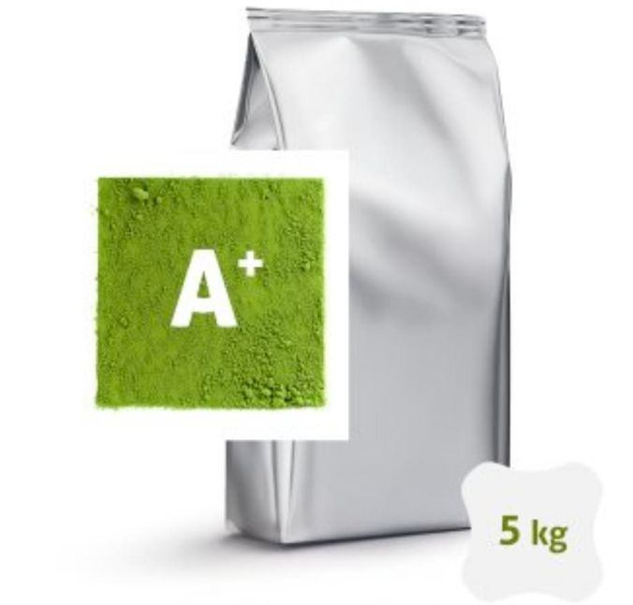

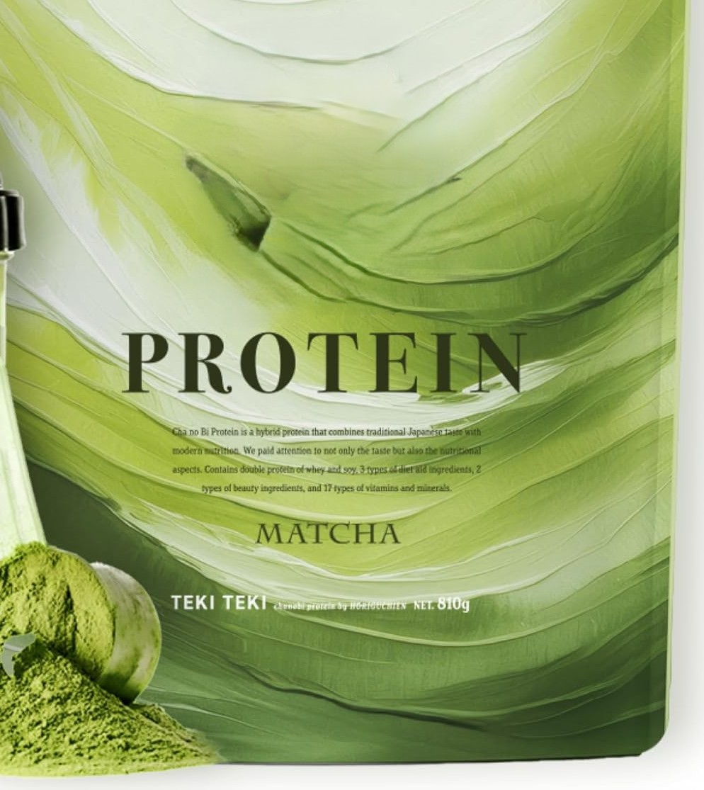
Product Lineup
Bulk and Industrial Solutions
Designed for food manufacturers, high-volume bakeries, and ice cream producers.
Origin | Shizuoka,
Weight | 1kg or 5kg
Certification | FDA, Gluten free
Shelf Life | 12 Months
Modern Wellness Innovation
Merging tradition with fitness. A high-demanded product for gym chains and health-focused wholesalers.
Origin | Kagoshima
Weight | 270g, 810g bag
Certification | FDA
Shelf Life | 12 Months

